Slide 1

Stable IDs from OpenStreetMap and combining data sources for use in crisis management
26/09/2024
how the NCCN uses OSM & authentic sources in Paragon

Slide 2
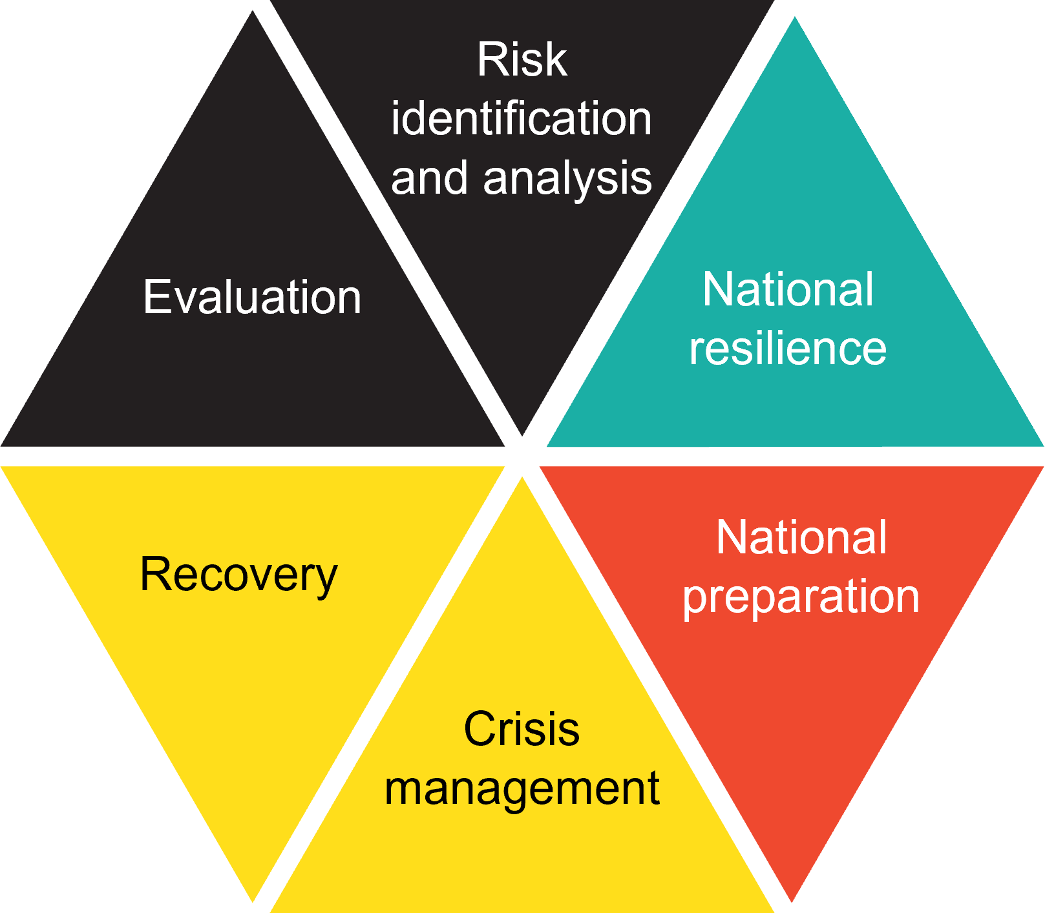
Paragon
National security platform
What is a security platform?
Cooperation between police, fire fighters, medical staff, logistics and communication
Crisis/national preparation + Crisis management
+ Database of emergency plans
Tackle a crisis as soon as possible!
Notes:
What is a national security platform?
Online platform in which all different disciplines – police, fire fighers, medical staff, logistics and communication – work together to solve an incident or local crisis
Not only useful during a crisis -> crisis preperation is also essential for this tool
Prepare events in Paragon (like national holiday, big sport event, festival… )
Partners make their preperations in Paragon – like setting all locations of police, way in/way out, …
Database with local EP’s -> easy access to get the necessary contact as soon as possible
Belgian risk cycle
Cycle how to prepare, tackle and evaluate a risk or problem
At the moment: National preparation and crisis management already in Paragon
Other elements will be implemented in Paragon in the future -> program that keeps evolving and improved
Conclusion: national security platform used to take necesary steps to tackle the crisis as soon as possible -> every second counts

Slide 3
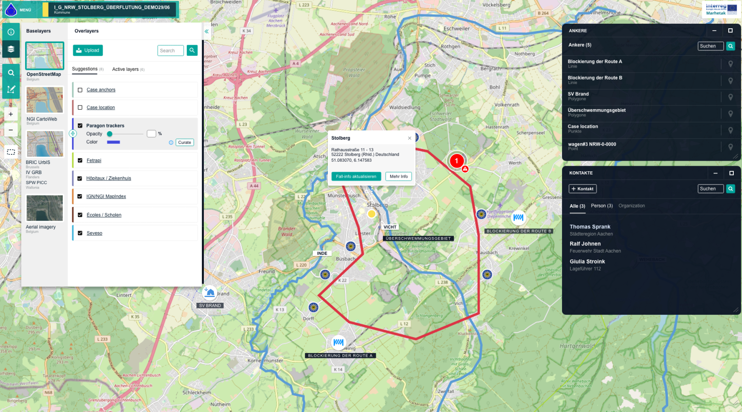
What is Paragon?
Screenshot Anchors
Notes:
Track & Trace
For the future -> implementing track & trace to local units to get a live overview of the situation
Would be anchors that move on the map
Still under development -> offers the most recent information to the crisis managers

Slide 4





Paragon
Paragon technical
Open source based
Webbrowser
Multilingual
Responsive design
Scalable
Notes:
Open source based ->
goverment project,
we have the ability to share this project,
transparancy with partners is essential
Scalablity
Not open source: maybe later – security concerns
Data processing: open source

Slide 5

Who AM I?
Joost Schouppe
Long-time data wrangler
One year at the National Crisis Centre
11 years of OpenStreetMap volunteering
Founding member of OpenStreetMap Belgium ngo
Former board member of Open Knowledge Belgium
https://en.osm.town/@joost_schouppe
Notes:
The fact that it’s open source built, attracted known names around here like Jonathan Beliën, Gael Kruwialis, Marc Ducobu

Slide 6








Paragon
Paragon key objects
Anchors
Emergency Plans
Contacts
Feed
Widgets
Case
Maps
Logistics
Notes:
Key objects:
Anchors: an object than you can put on a map -> example: a school, a municipality, a church, a drawing on the map
Emergency Plan: general idea of emergency plan -> Paragon adds to link useful contact persones, anchors etc to a case
Feed: communication app for all disciplines -> different communication channels
Widgets: different apps that each have their own functionality -> weather, feed, anchors…
Logistics: new functionality to get a general overview of available logistics

Slide 7
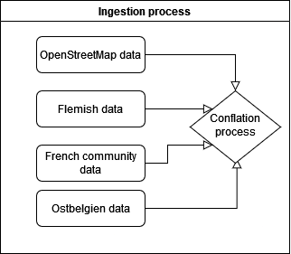
Many sources, many problems
But brought together = many solutions
R-scripts ran on an Airflow server
Notes:
And multiple solutions!
Unique issues, unique qualities
Combine to build something better than the parts

Slide 8
Official data
Strength
Complete*
Standardized (within the region)
Standardized update cycle
Weakness
Administrative reality
Different between regions
Geocoded address
Slow update cycle
Notes:
*: for what is in the administrative scope
“this case is not in the data because it doesn’t fit our world view” (e.g. temporary school)
Logic based on administrative processes; e.g. a school is not a site

Slide 9
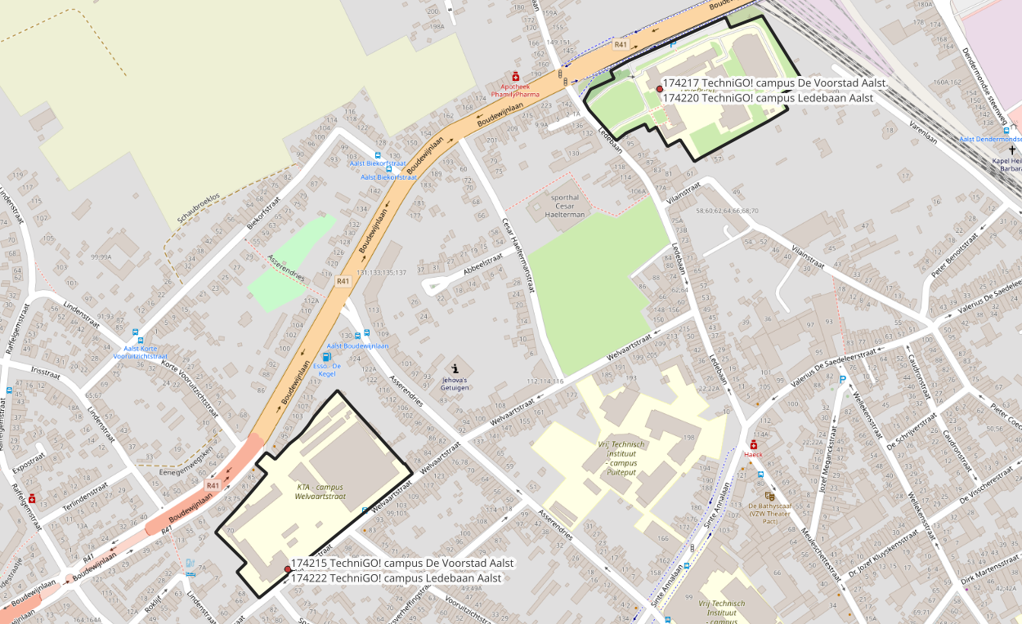

Slide 10
OpenStreetMap data
Strength
Detailed polygons
As you see it in reality
Continuous updates
Global data model (with local “dialects”)
Weakness
Limited on attributes (e.g. contact details)
Unstructured maintenance process
Completeness and detail very variable

Slide 11
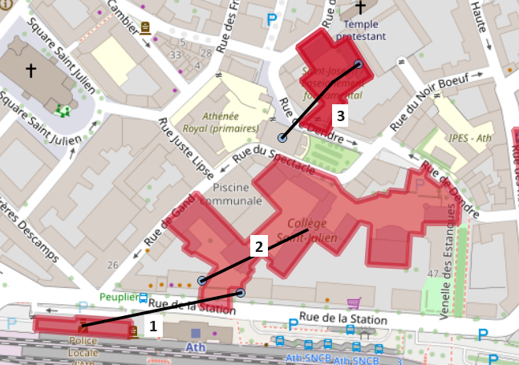
Best of both worlds
Notes:
Summarize the official data
Link to OSM data if available
Based on location, name, address, some attributes

Slide 12
Data source types
OFFICIAL DATA ONLY
Seveso sites
Pipelines
Nuclear installations
Population
Seaports
Bus & tram stops
Town halls
(Nursing homes)
(Nurseries)
MIXED DATA
Schools
Police stations
(Hotels)
OSM ONLY
Hospitals**
Firestations*
Airports*
Prisons*
Cultural centres*
Sports
Religious buildings
Train stations
Metro stations
Embassies
Wind turbines*
Notes:
So in the end, a lot of data comes either from official data sources (open data, close organizations)
But many layers are pure OSM data
Hospitals: will be merged in the future
(): not started yet
*: OSM data validated with official sources

Slide 13
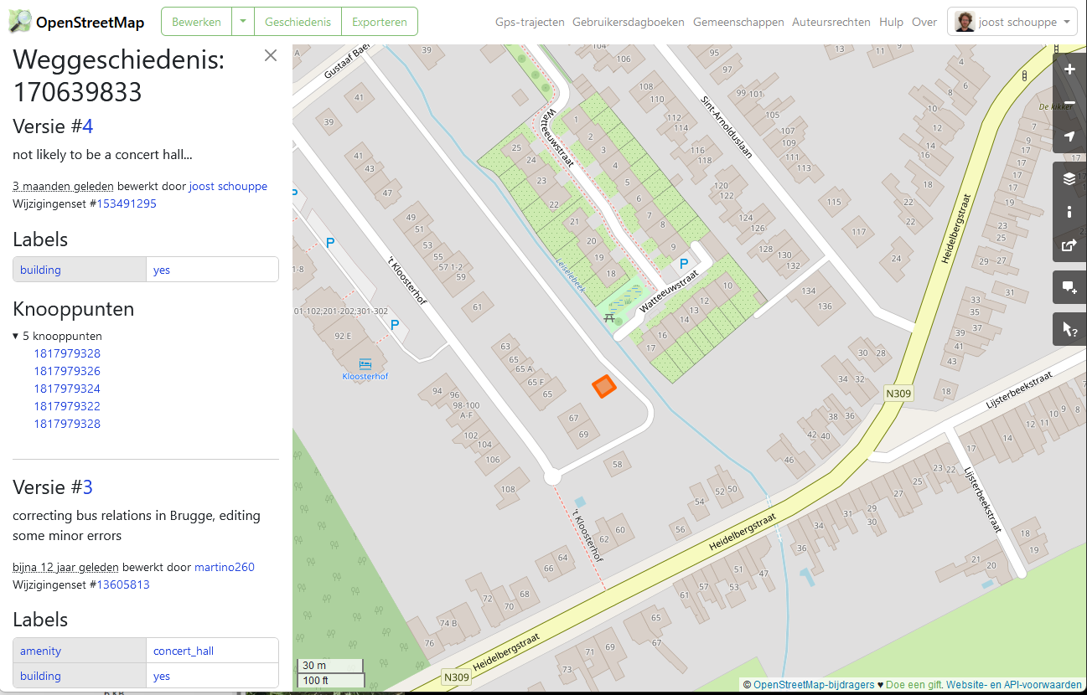
Notes:
Some manual reviewing of OSM data
Adding extra tags to clarify things, like
- type of fire station
- international airport vs any old airstrip
- hospital heliports

Slide 14
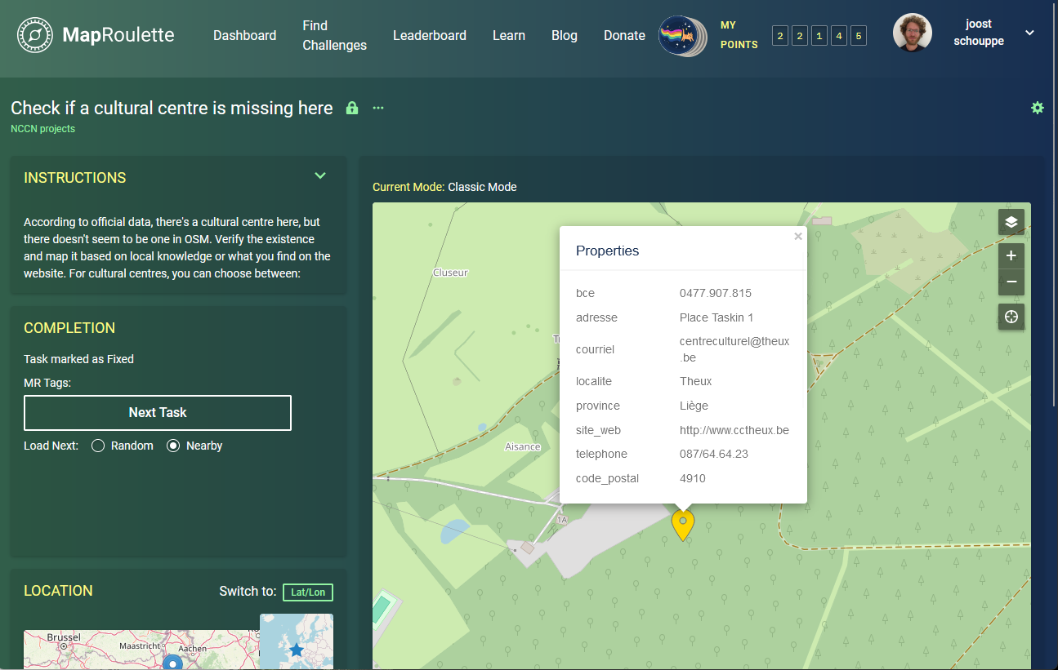
Notes:
Or comparing to official data
For example, a list of cultural centres in Wallonia
(unlikely place for a CC)
Or official list pf heliports

Slide 15
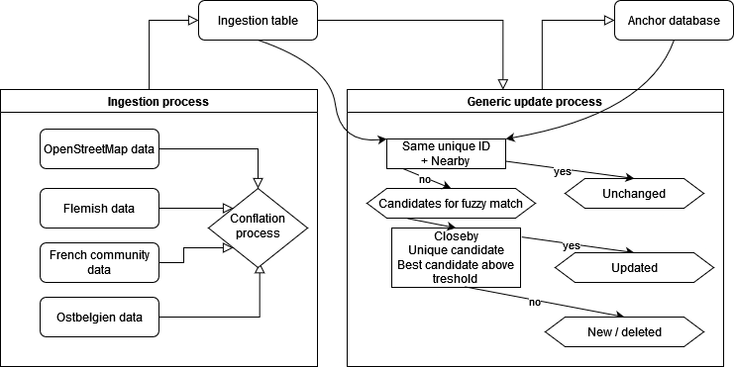
UPDATE PROCESS
Notes:
So then we have cleaned data, but how to maintain it

Slide 16
Generic process with parameters
INNER JOIN old & new based on original ID
Hausdorff distance if both polygon or line < variable treshold
Single candidate within threshold distance with same ID
Remove matches, then ST_JOIN with st_is_within_distance
Distance threshold
Unique candidate
To do: take in account name, join if distance=0
Write a report and some geoJSON for inspection
Automatic QA: fail if BBOX +/- 10%, new, deleted or updated > 10%
Update Postgres table with ON CONFLICT DO UPDATE logic
Notes:
R processes
To Postgres database
With vectortiles for rendering
Maputnik for styling the vectortiles
R libraries: osmdata, but moving towards maintaining a local copy of OSM

Slide 17




Paragon data team: paragon-data@nccn.fgov.be Help us improve OSM https://maproulette.org/browse/projects/54664 Use our code https://github.com/joostschouppe/NCCN-anchor-processing https://en.osm.town/@joost_schouppe
https://crisiscentrum.be @CrisiscenterBE
Notes:
Help us improve OSM for national crisis management

Slide 18
The general IDEA
Using official data or filters to identify issues in OSM
Current
Police offices in OSM but not in the official list
Schools in OSM that do not have a name
Schools in official data, but not in OSM (at all or as a polygon)
Past
Schools without a name, and not found in official data
Fire stations: full review of all stations with official list
Museums or cultural centres without a name
Poorly mapped cultural centres
Cultural centres in official data, but not in OSM

Slide 19
Your job
Review individual cases and fix them
Carefully reading the instructions
Using open data sources
Using the website of the subject
Using OPEN streetlevel imagery

Slide 20
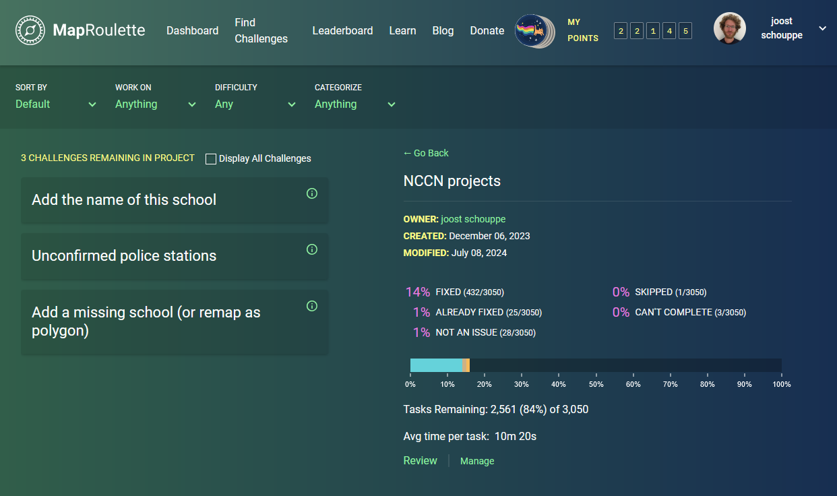
GETTING STARTED
https://maproulette.org/browse/projects/54664

Slide 21
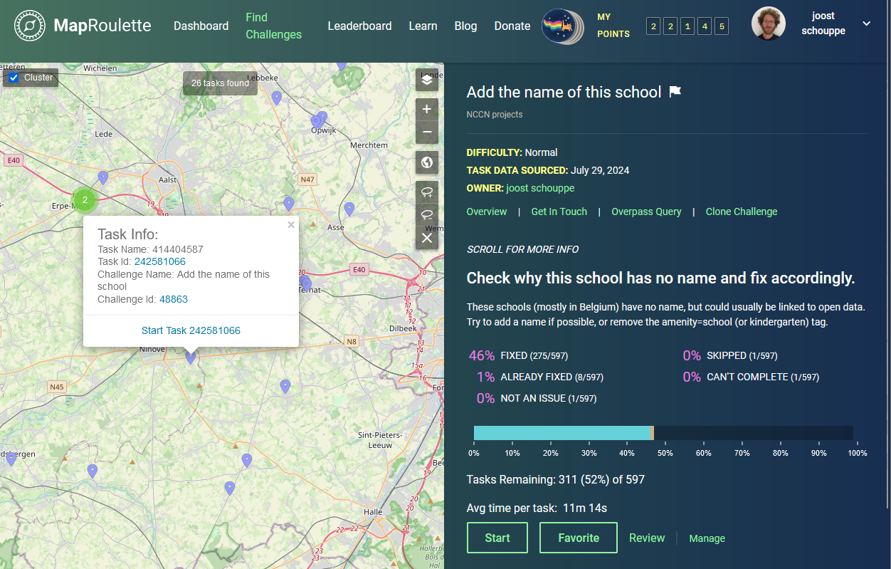
GETTING STARTED
Notes:
Just click “start” to go to a random point or
Zoom on the map till you see individual points and click “start task 1234566”

Slide 22
instructions
Check why this school has no name and fix accordingly.
Causes
Outline is correct but details on central point
> MOVE info from point to outline & delete point
Outline is just a school building in a correct school site
> REMOVE amenity=school
Not a school (anymore).
> Remove the amenity tag
Outline for more than one school.
Campus name available?
Add landuse=education
Check if at least one amenity=school within the polygon
It's complicated. Consider simplifying or simply mark it as too hard.
Process
- Check the official data
Search school website
Add a name or remove the amenity=school or kindergarten tag
Extra details:
school=kindergarten;primary;secondary
website, phone, email
alt_name with all the official schools

Slide 23
Example
https://maproulette.org/challenge/48863/task/242580937
Example (show these actions):
Delete tag or delete object
Add new tag if needed
Check Mapillary imagery
Save your change (comment: add very short description, including extra sources used)
Return to MapRoulette

Slide 24
CLOSE The task
I fixed it: all done.
Already fixed: the issue did not exist in the data anymore
Not an Issue: the data should not be changed
Can’t complete: I didn’t know what to do
Skip: I didn’t want to do this one
Special? Leave a comment
In doubt? Mark for review
On submit, pick “Nearby” for Next task

Slide 25
UNCONFIRMED POLICE STATIONS
Causes
False positive > not an issue
Old OSM data. (indicator: no recent edits, few tags). Delete & mark as I fixed it
it isn't quite a police station. Find better tag (e.g. office=government police=offices police:type=local|federal ) or mark as too hard
Process
Confirm existence with websearch or streetlevel imagery
Extra details: website, phone, street & housenumber
Map the info on the largest uniquely police-used area:
point: it's a part of a building with several uses
building: it's the only use of that building, and there is no clearly delineated area around the building that belongs to the police station
landuse area: there is a clearly delineated area only used by the police

Slide 26
ResOURCES
https://openstreetmap.be/en/contact : chat, forum, socials
Search: wiki openstreetmap the thing you want to do
https://resultmaps.neis-one.org/osm-changesets.php?comment=nccn

Slide 27
